Slide 1
The breadth and depth of instructional methods
David Taylor
dcmt@liv.ac.uk
http://www.liv.ac.uk/~dcmt

Slide 2
Strategies for facilitating learning
Let’s recap on what is involved in learning

Slide 3
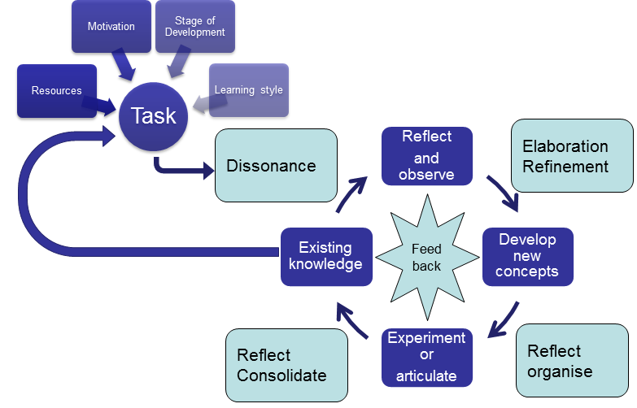
How people learn
Taylor and Hamdy 2013

Slide 4
There are four elements
Dissonance
Elaboration
Organising
Consolidating
Not necessarily in exactly that order – but they are all necessary

Slide 5
Dissonance

Slide 6
Dissonance – most important
Existing knowledge
Activate
Articulate
The task
Resources
Motivation, development, style
Not the only phase!

Slide 7
Elaboration and refinement

Slide 8
Elaboration and refinement
After observing and reflecting upon the dissonance
We develop a series of possible explanations
The “richness” and the “context” of the elaborations is important

Slide 9
Reflect and organise

Slide 10
Reflect and organise
We then have to narrow down the possibilities – choosing the best alternatives
Organise them into a story that makes sense
And test our ideas

Slide 11
Reflect and consolidate

Slide 12
Reflect and consolidate
We have articulated what we think or received the results of our experiment
And have received feedback
So we are in a position to affirm or reject our new ideas

Slide 13
Feedback is important

Slide 14
Think-Pair-Share
Your preferred method for:
Knowledge
Skills
Attitudes
How would you address each of the Quadrants?

Slide 15
Plenary
Your preferred method for:
Knowledge
Skills
Attitudes
Strengths/variety of approaches
How would you address each of the Quadrants?
Knowledge
Skills
Attitudes

